Slide 1


SmartSantander
Experimentation on
a real smart city deployment
Pablo Sotres
Fed4FIRE-GENI Research Experiment Summit University of Cantabria
Ghent, 7th July 2015 psotres@tlmat.unican.es

Slide 2
Let’s get our hands dirty

Slide 3
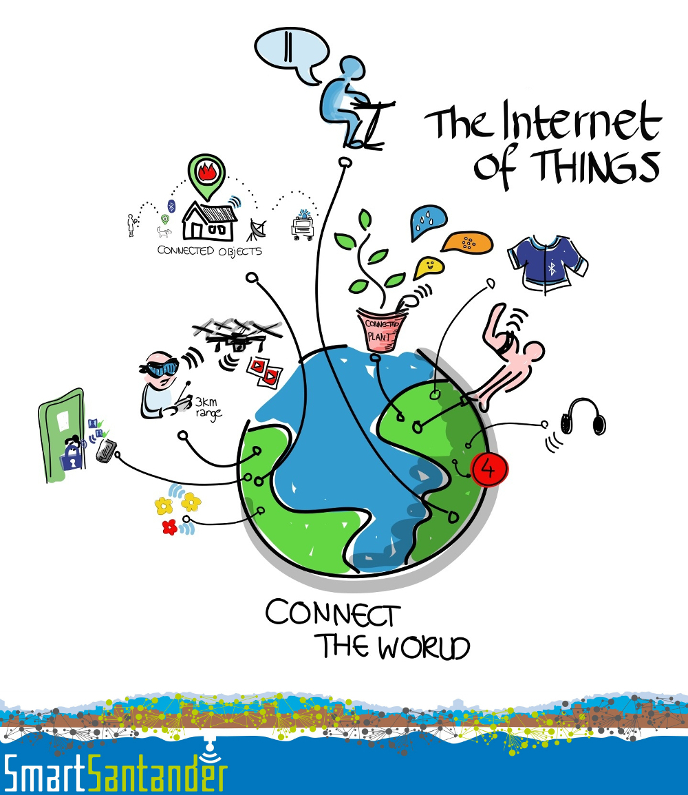

SmartSantander Service Layer (SEL)

Slide 4

SEL: What is the status?

Slide 5
SEL: What will it offer?
Sensor observations as a service
  Access to real time and historic sensor data
    Interactive via the documentation center
    Complex queries by using query definition language
    Subscription based access
Infrastructure information as a service
  Access to resource hardware description
  Access to phenomenon and UoM definitions

Slide 6
SEL: What will it offer?
User credentials management
  Different authentication schemas
    Fed4FIRE valid user certificate
    SmartSantander API keys
    Others
  Authorization level management

Slide 7
SEL: How can it be used?
Two different user roles:
  Infrastructure provider
    Use SmartSantander platform to publish its sensor data.
      Use case: Urban Services in Santander city (i.e. waste management service).
  Service data consumer
    Consumes sensor information from SmartSantander and provides added value services on top of it.

Slide 8
SEL: How can it be used?
A combination of both is also a valid role:
    Aggregate raw sensor data.
    Generate virtual sensors based on it.
    Register them in SmartSantander.
    Inject these virtual observations for others to use.

Slide 9
SEL: How can it be used?
Two different user roles:
  Infrastructure provider
    Use SmartSantander platform to publish its sensor data.
      Use case: Urban Services in Santander city (i.e. waste management service).
  Service data consumer
    Consumes sensor information from SmartSantander and provides added value services on top of it.

Slide 10
SEL: Basic interactions
In SmartSantander, a SEL experimenter can interact with these components:
  The resource directory (RD)
  The phenomena and UoM directory (PUD)
  The asynchronous subsystem (SCQS)
  The synchronous subsystem (Service Data Repo)
  The user directory

Slide 11
SEL: Basic interactions
In SmartSantander, a SEL experimenter can interact with those components:
  The resource directory (RD)
  The phenomena and UoM directory (PUD)
  The asynchronous subsystem (SCQS)
  The synchronous subsystem (Service Data Repo)
  The user directory

Slide 12
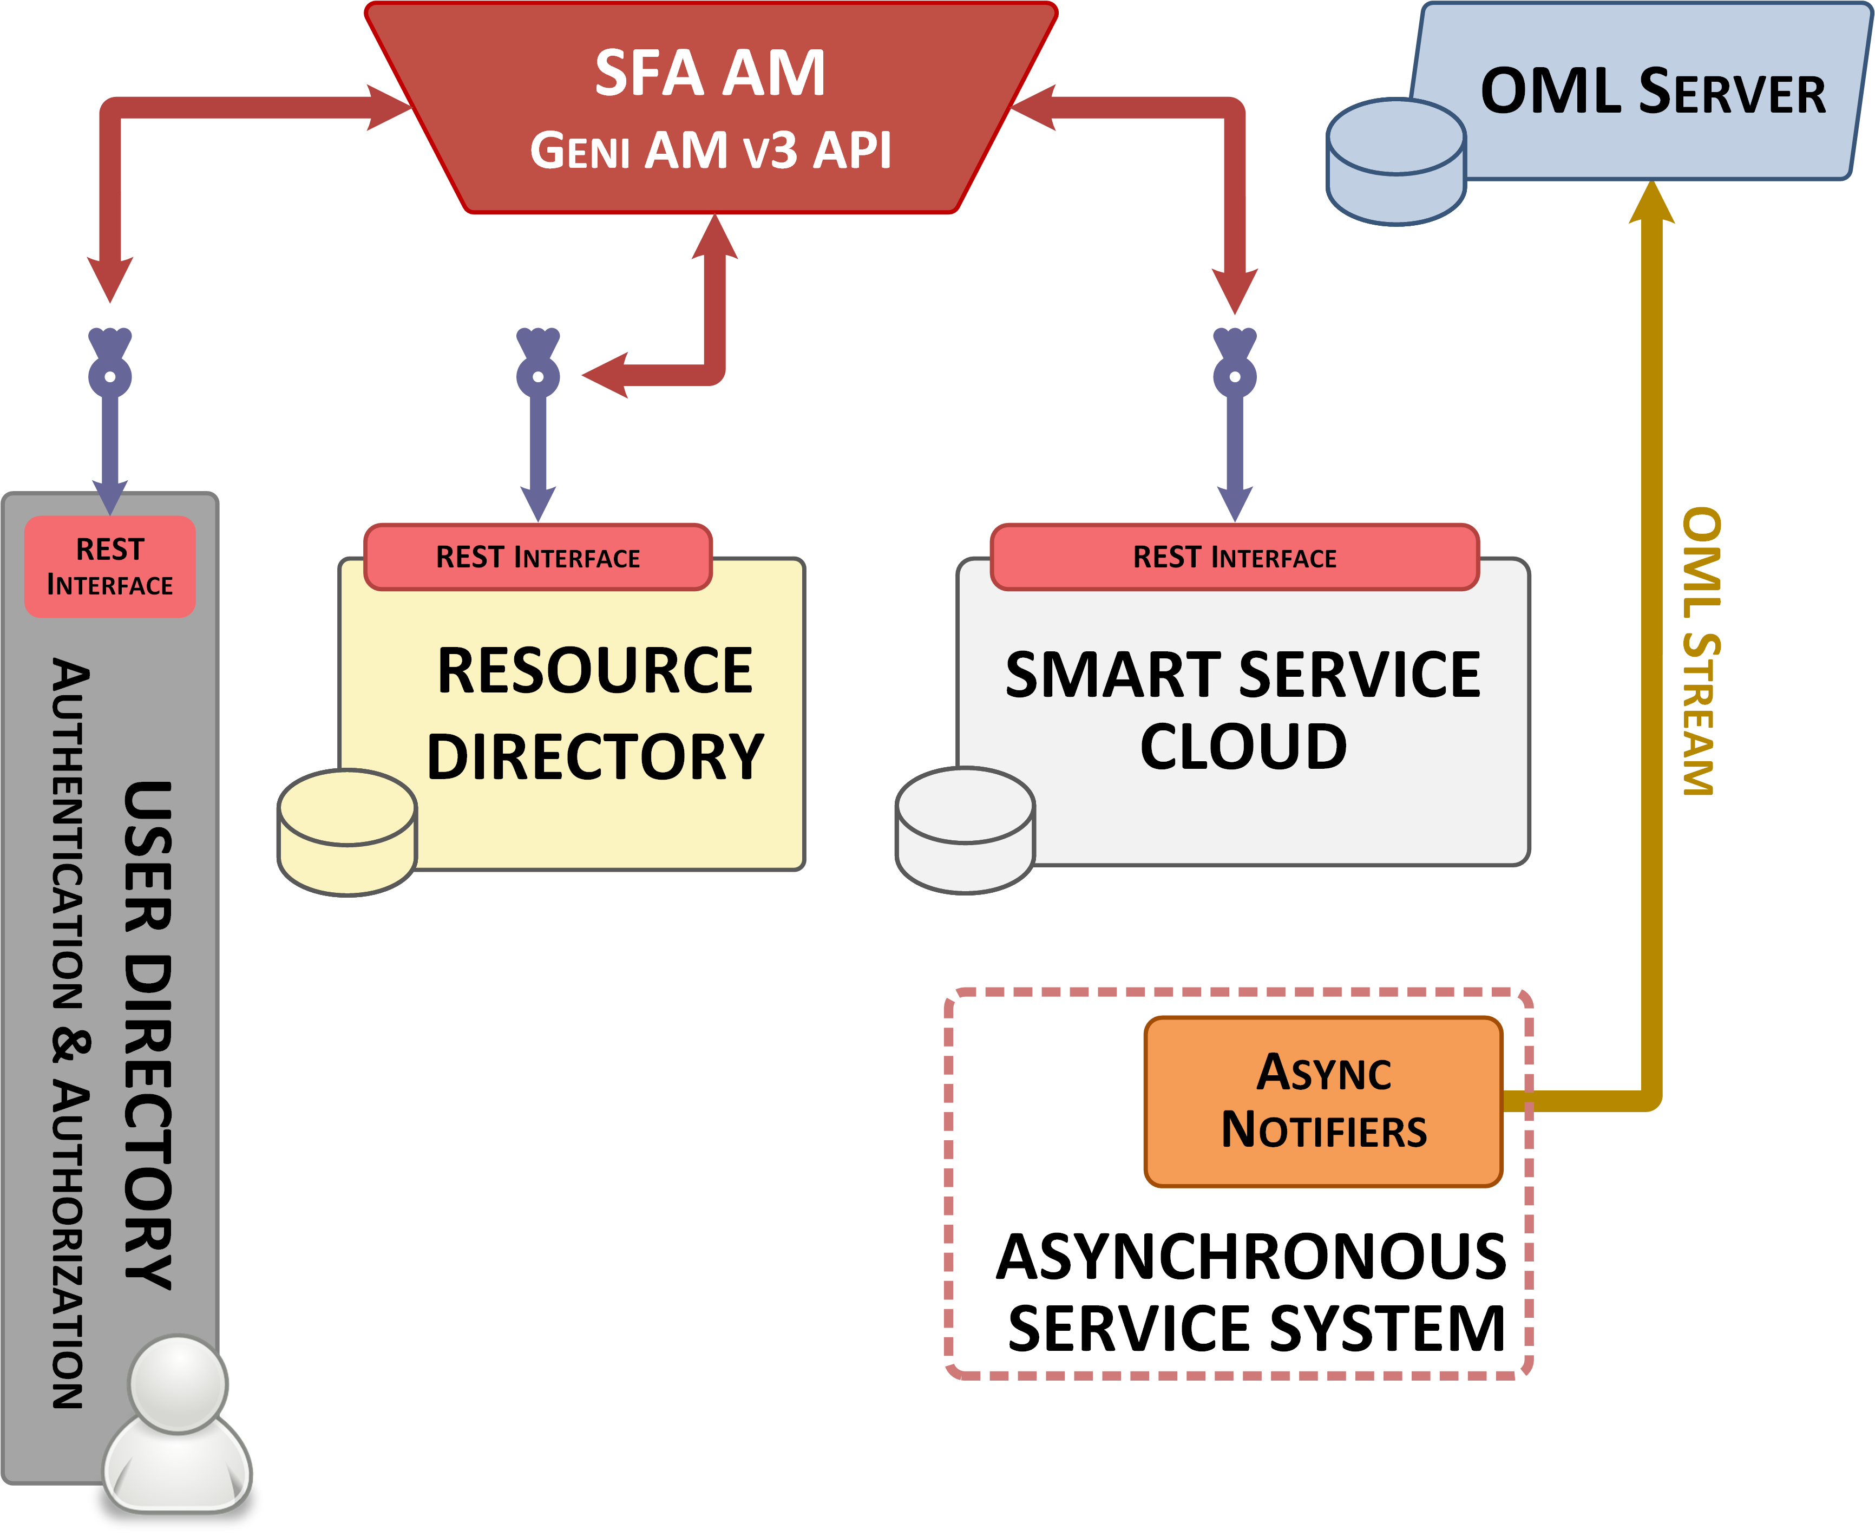
SEL: How we plan to integrate SFA

Slide 13
SmartSantander Service Layer (SEL)

Slide 14
SEL: Basic terminology
Node vs Sensor ←→ Observation vs Measurement
  1 Node can contain more than 1 sensor →(1:N)
  Nodes generate observations, which can contain more than 1 measurement (each one coming from a different sensor)
Capabilities vs Phenomena vs UoM
  A capability is the combination of a phenomena and its UoM
  A node can have several capabilities, one derived from each of its sensors
  The same phenomena can be measured in different UoM

Slide 15
SEL: Basic sensor data models
Simple measurement model
Simple observation model
Nested measurement model
Nested observation model

Slide 16
SEL: Simple measurement model
{
"urn":"urn:x-iot:smartsantander:u7jcfa:fixed:10013",
"timestamp":"2014-04-30T11:41:01.123+02:00",
"location":
{
"coordinates":[-3.8643275,43.4664959],
"type":"Point"
},
"phenomenon":"temperature:ambient",
"value":23.01,
"uom":"degreeCelsius"
}

Slide 17
SEL: Simple observation model
{
"urn":"urn:x-iot:smartsantander:u7jcfa:fixed:10013",
"timestamp":"2014-04-30T11:41:01.123+02:00",
"location":
{
"coordinates":[-3.8643275,43.4664959],
"type":"Point"
},
"measurements":
[
{
"phenomenon":"temperature:ambient",
"value":23.01,
"uom":"degreeCelsius"
}, {
"phenomenon": "relativeHumidity",
"value":56,
"uom":"percent"
}
]
}

Slide 18
SEL: Asynchronous subscriptions
{
"target": {
"technology": <"http" | "oml">,
“parameters": {}
},
"query": {
"what": {
"format": <"measurement" | "observation">
"_allOf": [what_criteria_a1, what_criteria_a2, …, what_criteria_aN],
"_anyOf": [what_criteria_b1, what_criteria_b2, …, what_criteria_bN],
"_not": [what_criteria_c1, what_criteria_c2, …, what_criteria_cN]
},
"where": {
"_allOf": [where_criteria_a1, where_criteria_a2, …, where_criteria_aN],
"_anyOf": [where_criteria_b1, where_criteria_b2, …, where_criteria_bN],
"_not": [where_criteria_c1, where_criteria_c2, …, where_criteria_cN]
},
"when": {
"_allOf": [when_criteria_a1, when_criteria_a2, …, when_criteria_aN],
"_anyOf": [when_criteria_b1, when_criteria_b2, …, when_criteria_bN],
"_not": [when_criteria_c1, when_criteria_c2, …, when_criteria_cN]
}
}
}

Slide 19
SEL: Async subscriptions <target>
{
"technology": "oml",
"parameters": {
"address": <destination endpoint (IPv4)>,
    "port": <destination port>,
    "experiment“: <OML experiment id>,
    "application“: <OML application name>
}
}
{
"technology": “resthooks",
"parameters": {
“url": <destination endpoint (IPv4)>
}
}

Slide 20
SEL: Async subscriptions <what>
{
"phenomenon": <phenomenon>,
"filter": {
"uom": <uom>
"value": {
// AND is applied
"_eq": <string> or <number>,
"_ne": <string> or <number>,
"_in": [<string> or <number>],
"_nin": [<string> or <number>],
// operators for strings
"_regexp": <regexp>
// operators for numbers
"_gte": <number>,
"_gt": <number>,
"_lte": <number>,
"_lt": <number>
}
}
}

Slide 21
SEL: Async subscriptions <where>
{
// Either one or the other, not both at the same time
"resources": {
// Either one or the other, not both at the same time
"_in": [urn1, urn2, urn3],
"_regexp": [<regexp1>, <regexp2>]
},
"area":
// Use one of geoJSON standard geometries or the circle format included in
// the draft proposal on https://github.com/geojson/geojson-spec/wiki
<JSON extended geometry>
}
}

Slide 22
SmartSantander SEL experimentation
Asynchronous access hands-on tutorial

Slide 23
Remarks for the FGRE Team Projects
Subscription stitching component won’t be available before Friday. This means that even though you will be able to generate subscriptions and experimenting on the platform as we intended, the engine in charge of matching them with actual observations won’t be working. Sorry for the inconvenience.
As a workaround ONLY during this week, ALL generated measurements will be sent to the fgre2015 OML server for you to access them. Details are on one of the last slides.
As explained during the tutorial, at this moment not all the phenomenons listed on the SmartSantander directory are yet integrated on the asynchronous subsystem.

Slide 24
What will you need
A web browser
Fed4FIRE valid credentials
Postman (or any other similar tool) to interact with a REST API
jFed to interact with SFA
Start thinking on heterogeneous information, not in terms of individual resources
An idea of what you want to achieve

Slide 25
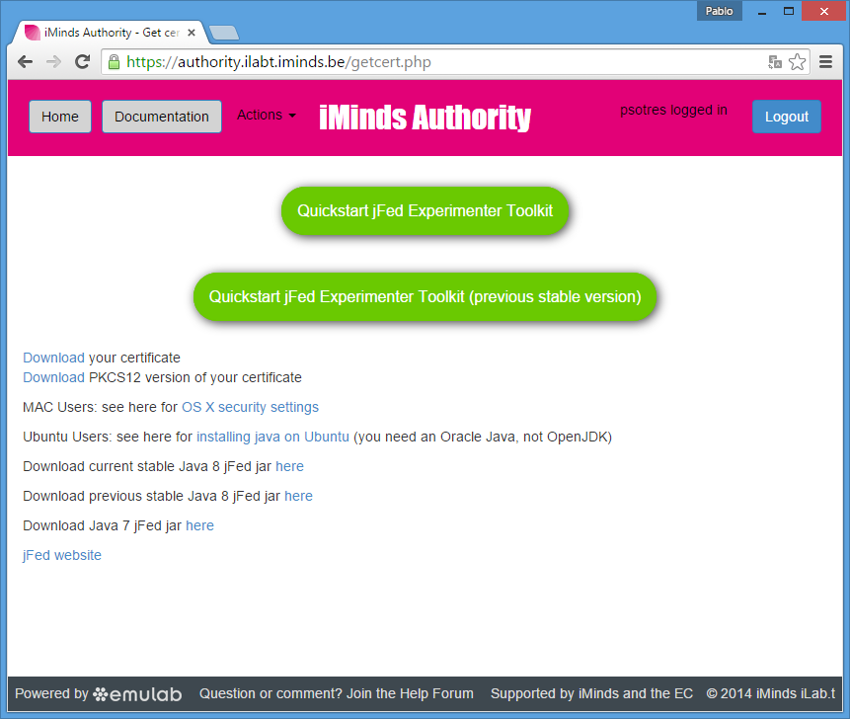

Slide 26
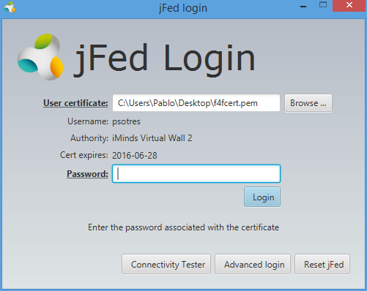

Slide 27
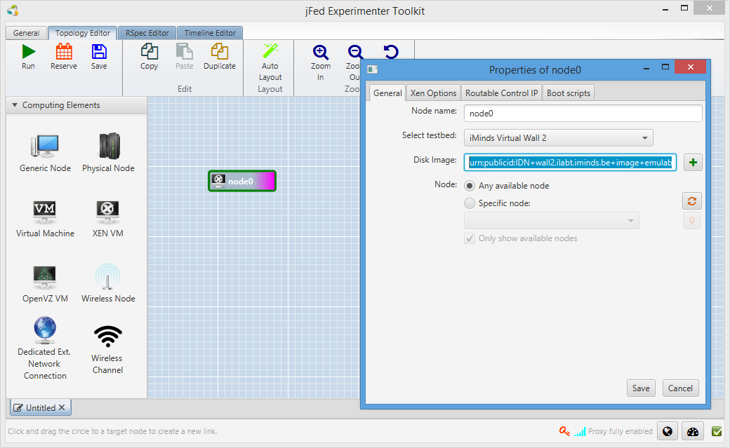
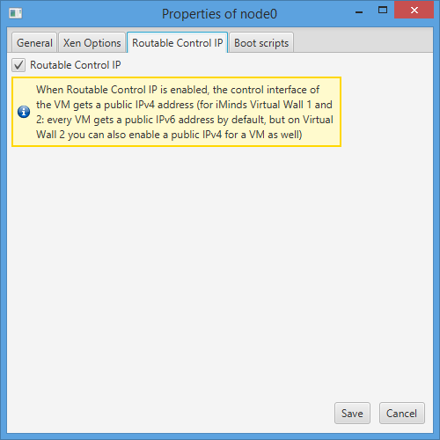

Slide 28
Set up the demo environment
Reserve a VM with public IPv4 using jFed (XEN VM)
Download the demo environment we have prepared
    wget --content-disposition https://api.smartsantander.eu/demos/fgre2015
    tar xzvf fgre-demo.tar.gz && cd fgre-demo && ./bootstrap.sh
Follow the instructions to run it
Make a subscription to SmartSantander SEL

Slide 29
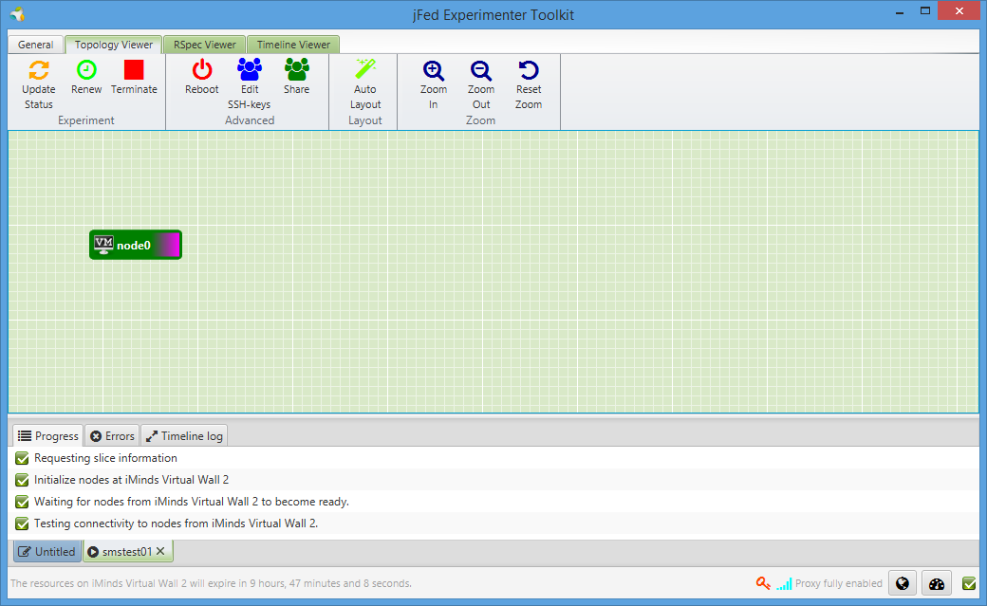
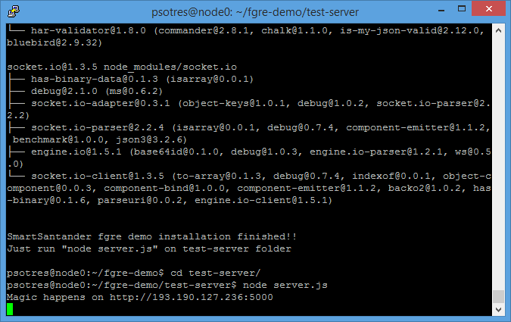

Slide 30
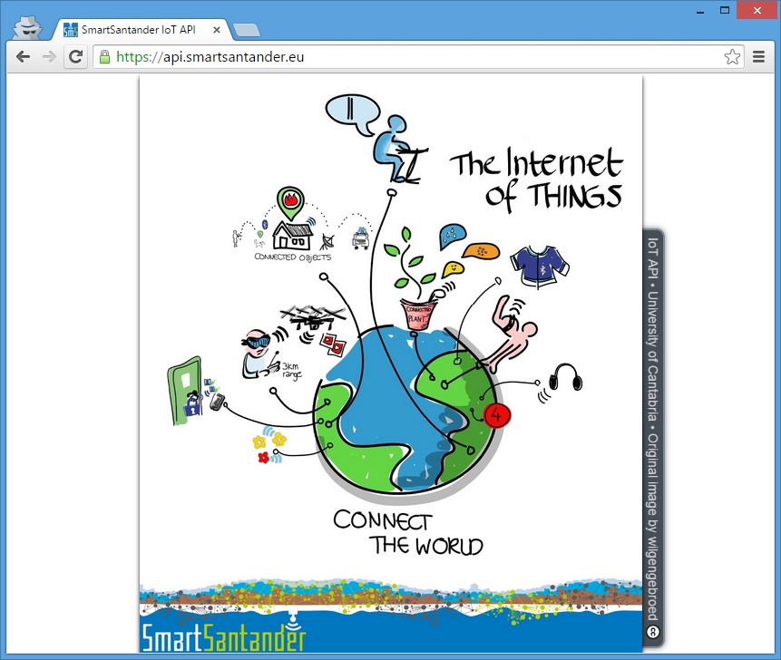

Slide 31
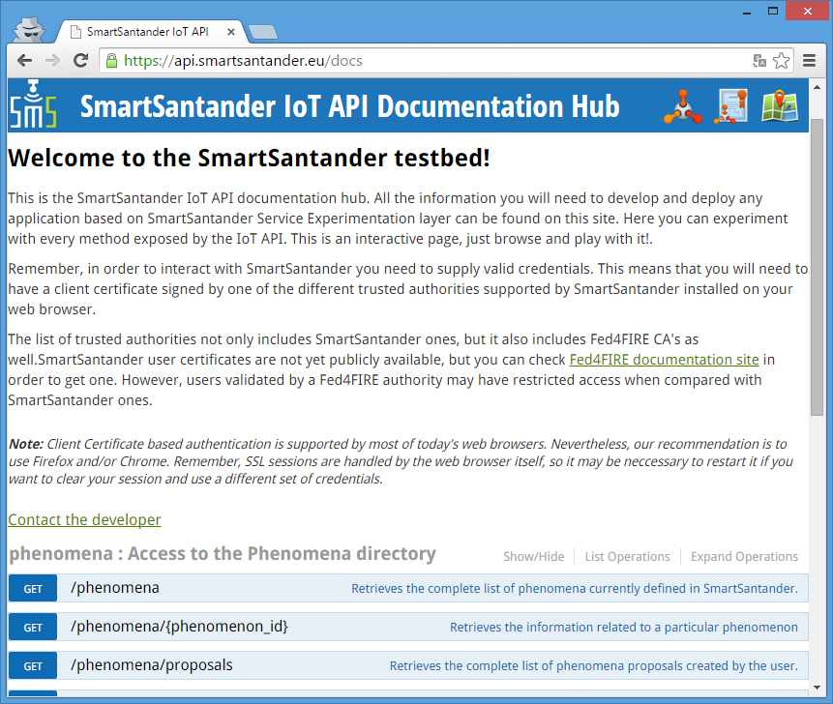

Slide 32
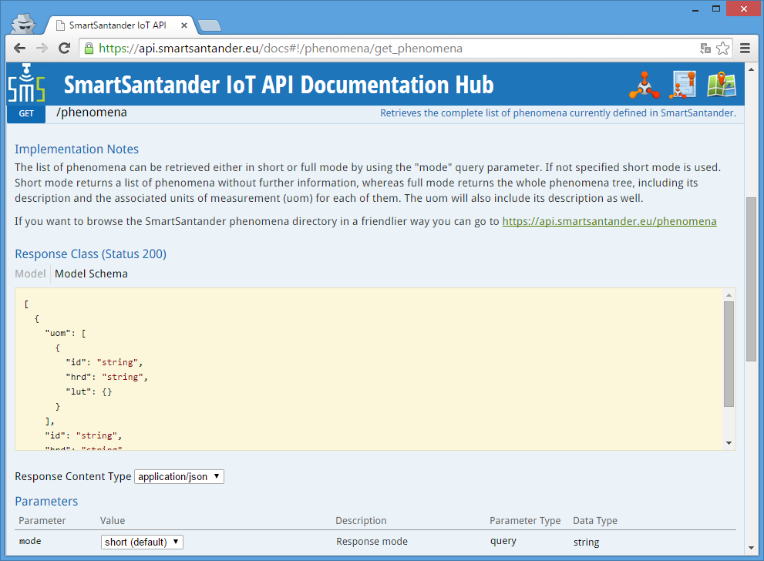

Slide 33
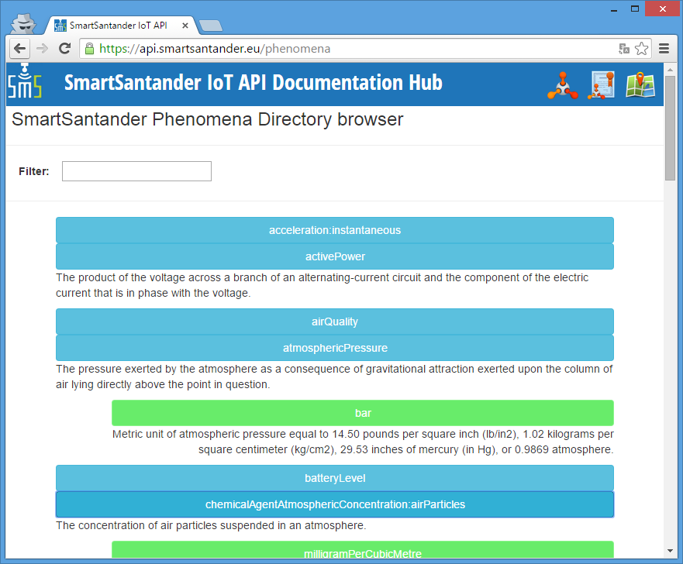

Slide 34
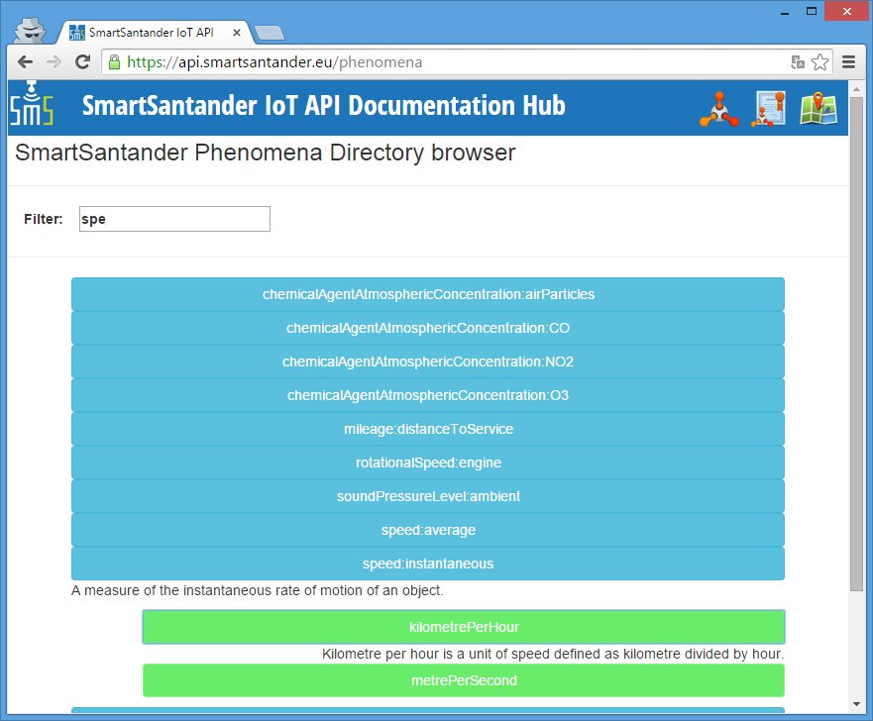

Slide 35
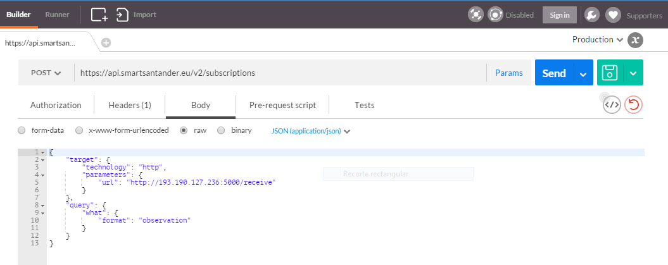

Slide 36
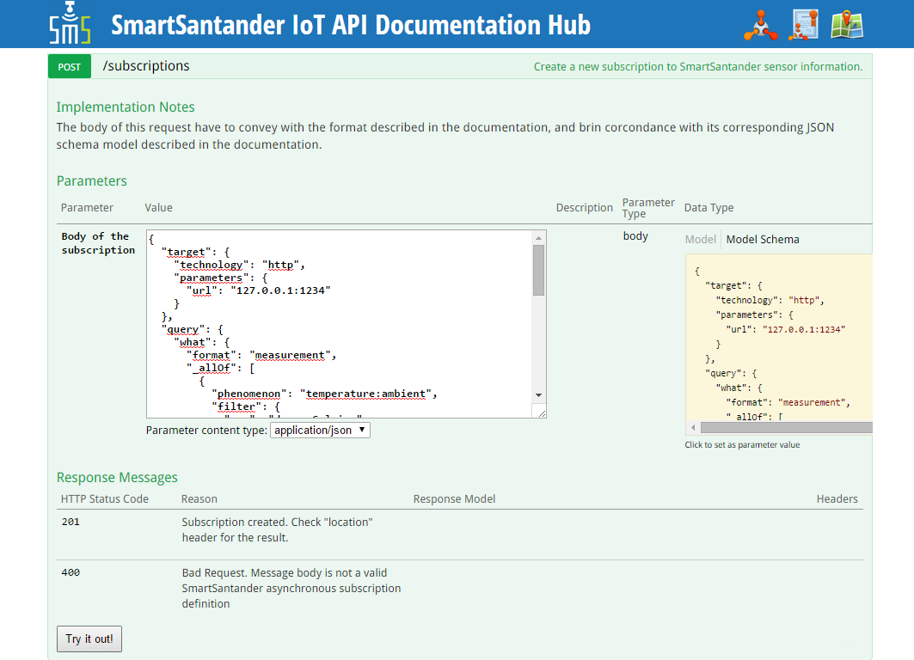

Slide 37
{
"target": {
"technology": "http",
"parameters": {
"url": "http://193.190.127.236:5000/receive"
}
},
"query": {
"what": {
"format": "measurement",
"_allOf": [
{
"phenomenon": "temperature:ambient",
"filter": {
"uom": "degreeCelsius",
"value": {
"_gt": 5
}
}
}
]
},
...
...
"where": {
"_allOf": [
{
"area": {
"type": "Circle",
"coordinates": [
43.462403,
-3.810011
],
"radius": 0.5,
"properties": {
"radius_units": "km"
}
}
}
]
}
}
}

Slide 39
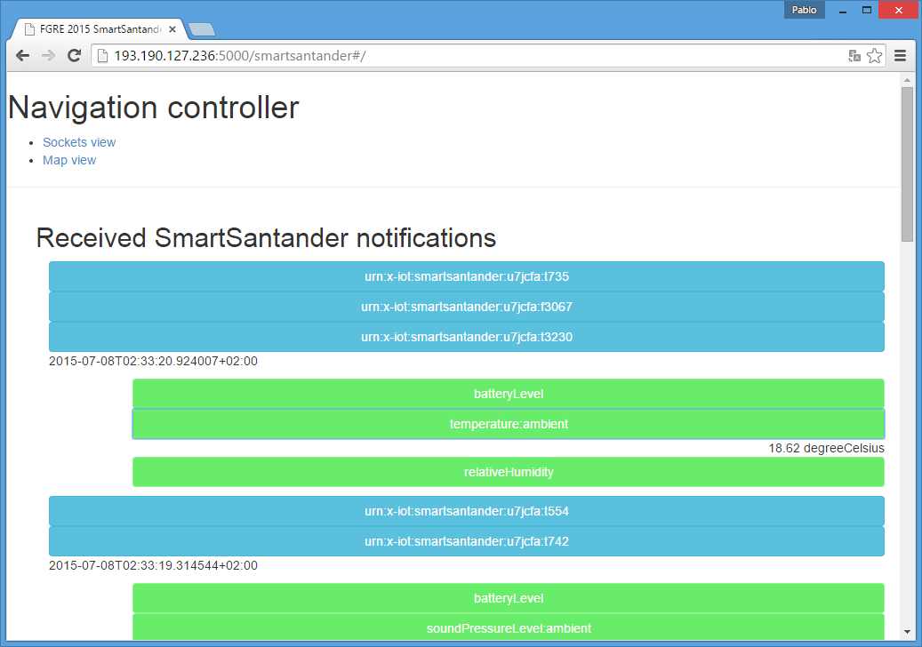

Slide 40
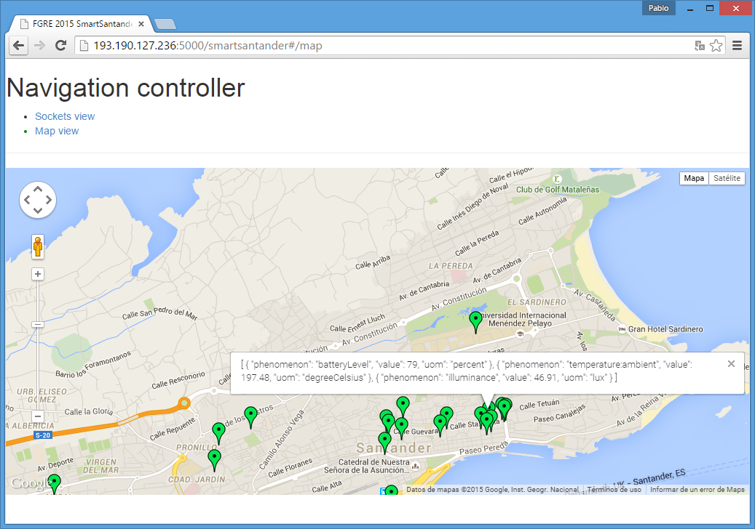

Slide 41
Why not to try OML?
Use demo OML server or your own one!!
  http://193.190.127.232/phppgadmin
  credentials → oml:fgre
{
"technology": "oml",
"parameters": {
"address": "193.190.127.232",
    "port": "3003",
    "experiment": "fgreExp",
    "application": "fgreApp"
}
}

Slide 42
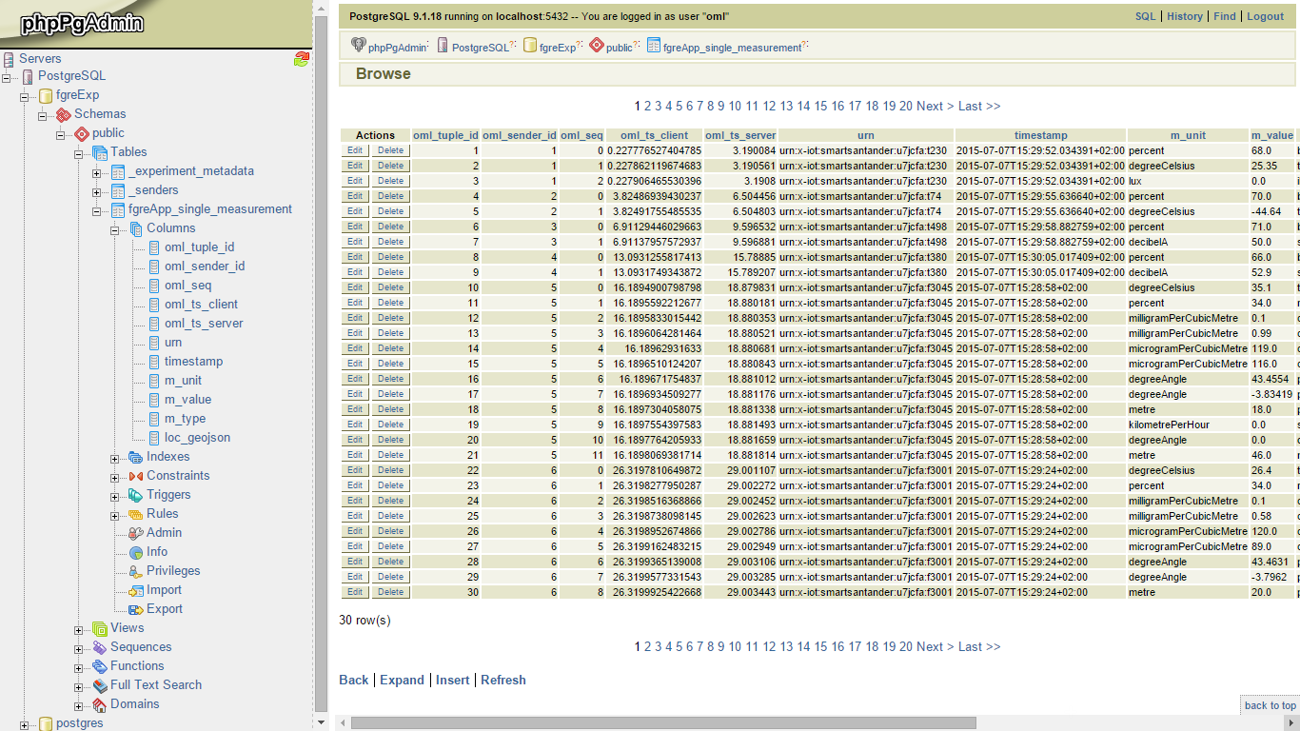

Slide 43
Now it’s your turn to start thinking and generate something new out of this raw sensor data!!

